Slide 1

Developing a Strategic Marketing Plan
Warm welcome to SMP 16 participants
June 2020

Slide 2
Agenda
Understanding Customers (June 14, 2020)
Creating a product strategy (June 21, 2020)
Managing Distributions/ Channel Challenges (June 21, 2020)
Communicating to customers (June 28, 2020)
Pricing it right (June 28, 2020)

Slide 3
A quick recap!
What you remember from Pre-COVID era!

Slide 4
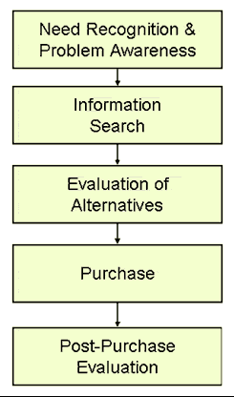
Decision Making Process
The simplest is the:
  A-I-D-A model
  More ‘detailed’ models

Slide 5
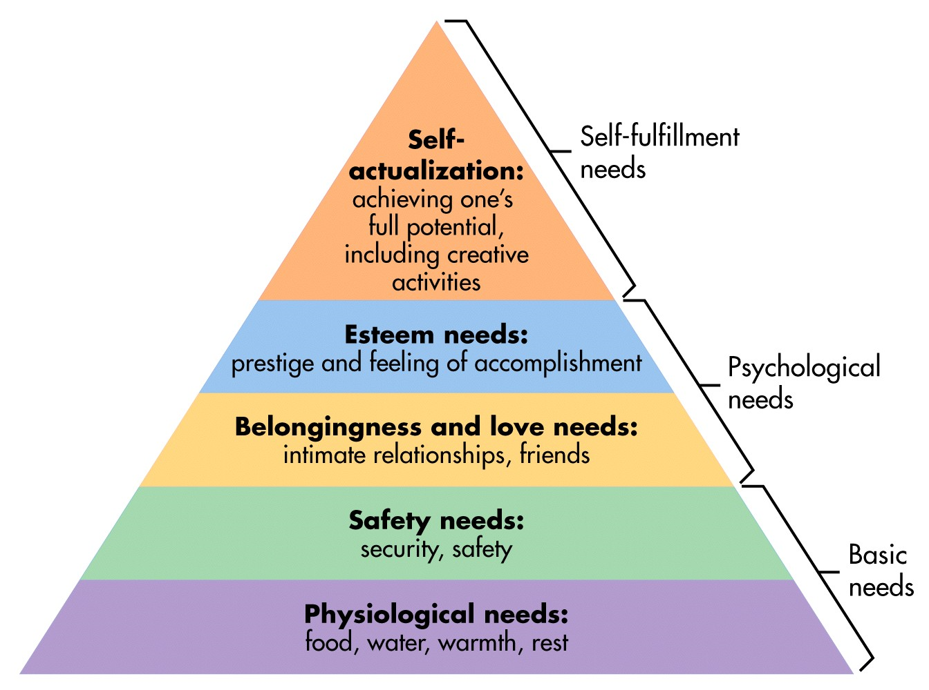
Need, Want and Demand

Slide 6
The process in flow!
Perception
Attitude
Self Realised
Need Recognition
Evaluation
Decision
Family & Social
MMix
Learning
Personality

Slide 7
The Consumer Decision making process
Inputs
Firm level 4P/7P
Socio Cultural Components
Process
Need Recognition- Motivation
Purchase-post purchase
Trial
Purchase
Family & Reference Groups
Informal sources
Social Class
Perception
Learning & Prior Experience
Attitudinal Dimensions
Personality
Post purchase evaluation

Slide 8
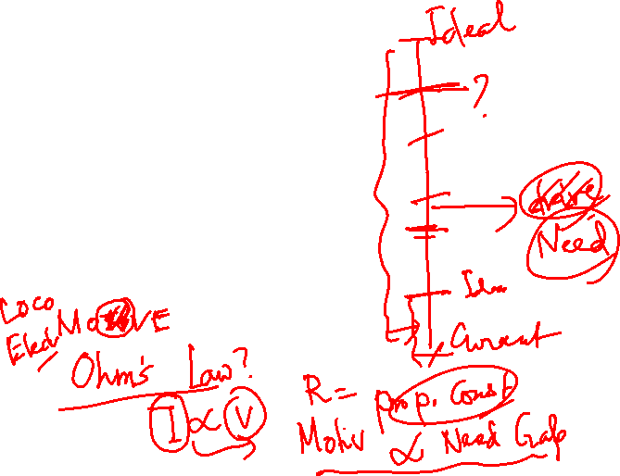
Needs and Motivation
Cornerstones of Motivation and Needs Studies
  Maslow’s Hierarchy of Needs
  Freudian Paradigm
  Drive Theory
    Gap Between the Current State and Desired State
    Magnitude of the ‘Gap” is important
    Homeostasis

Slide 9
Needs and Motivation
Expectancy Theory
  ……. motivation of the behavior selection is determined by the desirability of the outcome. However, at the core of the theory is the cognitive process of how an individual processes the different motivational elements. This is done before making the ultimate choice. The outcome is not the sole determining factor in making the decision of how to behave.
Emergence of Involvement as a Mediator
  Emerged a critical aspect in the online context

Slide 10
Needs and Motivation
Intrinsic and Extrinsic Needs
  Need for own self
    Comfort and Convenience
  Other directed Need
    Impress, status enhancer
  Maybe linked to a single product
  Trade-off Motivators
    Healthy and Tasty

Slide 11
Positive and Negative Motivation
Approach (positive) and Avoidance (Negative) Goals
  Approach-
    Fair and Lovely Fairness Cream- Airhostess
  Avoidance
    Fair and Lovely Dark Circle Remover Cream
    Dettol
    Cease-Fire
Rational & Emotive Needs

Slide 12
Personality & its Dimensions

Slide 13
Personality
Makes people Unique
  Refers to a person’s reaction to his environment
  Is it consistent?
    Are we consistent? Always?
  Enduring
    True?
  Interesting aspects for Lifestyle Marketing
  Do people consume products or symbolism?
    Ernest Dichter

Slide 14
Personality
Paradigms in Personality
  Freudian Systems
    Id-
      Oriented towards Immediate Gratification
      Party Animal
      “TATA SAFARI- It is a jungle out there”
    Superego
      “Counterweight” to Id
      Conscience
      Social Focus
    Ego
      Balances between the two extremes
      Product Symbolism is key- “vicarious experience of the forbidden fruit”

Slide 15
Personality
Other Neo-Freudian Paradigms
  Resulted from unacceptability of motivation around sexual orientation as proposed by Freud
  Karen Horney
    CAD
  Carl Jung- father of Analytical Psychology
    Archetypes- handed down from the experience of
      Fear of Dark
      Old Wise Man
      Earth Mother

Slide 16
Personality
Trait Theory
  Introversion- Extroversion (Reserved vis-à-vis Outgoing)
  Materialism (importance on acquiring things)
  Innovativeness (Tries out new things)
  Self-Consciousness (Deliberately monitors him/herself)
  Need for Cognition ( likes to think about things)
  Problems with Trait Theory
    Validity with Scales
    Need to be modified according to context
    Specific sections- mentally ill!! 

Slide 17
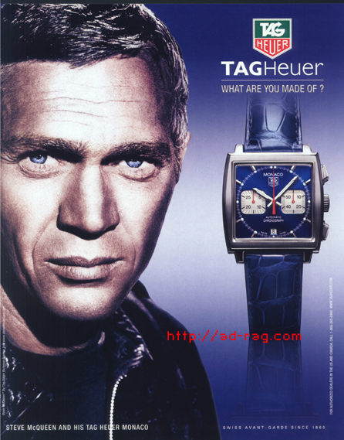
What are you made of?

Slide 18
Personality
The Self or the Selves
  Multiple Selves
    A father, a friend, a husband, a son, or just a man
    Titan Raga
  Extended Self
    Attribution to a product/ ‘concept’
  Actual/ Ideal
  Expected Self
    GNIIT
 | Internal | External
Actual | Actual self | Social Self
Ideal | Ideal Self | Ideal Social

Slide 19
Perception

Slide 20
Perception
Sensation
  Absolute or relative
Absolute threshold
  Sensory Adaptation
    Cosmetic Changes
    Substantive Changes

Slide 21
Perception
Differential threshold
  Weber’s Law
    Amount of change that is necessary to be noticed is systematically related to the intensity of the original stimulus
  JND
    Campbell’s Soup
    Nestlé Munch
    Pond’s Dreamflower Talc- 30% more

Slide 22
Perception
Previous Experiences
Motives
Selection of Stimuli
Recognition of Stimuli
?
Interpretation
Organization

Slide 23
Perception
Selection
  Contrast
    More-
    J & N
    Bright color ads in Newspaper
    Black and White ads in a glossy colorful magazine
    Less-
    Advertorials
    Nature Fresh
    Showing ad clips during high involvement serials- often depicting the actors in those advertisements
    Importance of “Figure and Ground”

Slide 24
Perception
Perception and Pricing
  Reference Prices
    Internal Reference Price
      Through Learning, advertising, product category
    External Reference Price
      Through Marketers’ Claims. “create value”
  Transaction Utility
    Internal Reference Price ~ Purchase Price
    Change Internal Reference Price (?)
  Acquisition Utility
    U(x) ~ Purchase Price
    “Enhance Experience”

Slide 25
Perception
  Assimilation – Contrast Theory
    High Plausible
    Low Plausible
    High Implausible
    Low Implausible
  Marketer’s Implications

Slide 26
Learning

Slide 27
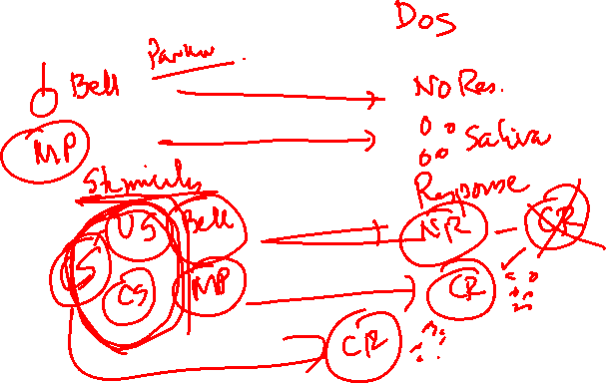
Learning
Classical Conditioning
  Pavlovian Dog
  Brand Recognition
    Learning
  Advertisements
    “Wear out” issues
      Cosmetic Variation
      Substantive Variation
  3 Hit theory
    Awareness
    Relevance
    Reminding

Slide 28
Learning
Classical Conditioning
  More recent theoretical Implications
    Pepsi - associations
  Cognitive Associative Learning
    Repeated associations
Information
+
Representation
Events

Slide 29
Learning
Classical Conditioning
  Stimulus Generalization
    NIRMA- Nima
    Promise
    Soft Drinks Market
    Brands with distinct/ strong images may fall prey
  Extension
    Line, Form and Category
      Brand Extensions
      Family Branding
      Industrial vis-à-vis Consumer goods

Slide 30
Learning
Classical Conditioning
  Licensing
  Generalization of Usage?
  Stimulus Discrimination
  Positioning
  Product Differentiation
    New
    Improved
    Better
    More

Slide 31
Learning
Observational Learning
  Vicarious Learning
    Children learn watching parents, siblings
    Largely with Negative reinforcement but also some with positive reinforcement
    Fair and Lovely
      Most of recent communication depict scenes of common people- “Slices of Life”

Slide 32
Learning
Cognitive Learning Theory
  Information Processing individual
    Familiarity with category aids in processing
  Structure of Memory
    Sensory Store
    Short Term memory
    Long Term memory
      Through Rehearsal
      Encoding
    Retention
      Formation of Schema

Slide 33
Perfumes
Associative Networks
Eau de Toilette
Colognes
young
Floral Scents
Charlie
Elegant
Calvin Klein
Obsession
Chanel
Poison
rich
Elizabeth Taylor
White Linen
sexy
Rolls Royce
Cher
Victoria’s Secret
Mercedes Benz

Slide 34
Attitude

Slide 35
Attitude
Attitudes
  A ‘Learned’ pre-disposition
    Directed- Either towards or Away
  Attitude Object
    Brand
    Product Category
    Or a Product
  Attitude Formation
    Direct Experience
    WOM
    Information

Slide 36
Attitude
Attitudes are lasting
  Towards Smoking
Attitudes can change
  With respect to a situation
  Capitalize
    Create unique positioning
    Firoz hates Fast Food, but for Late nights from his office, he walks into the local Pizza store
    Anand hates to splurge, but just might buy a diamond ring for his girlfriend

Slide 37
Attitude
Attitude Models
  Tri-component Attitude Model
  3 Parts- Cognition-Affect & Conation
Affect
Cognition
Conative

Slide 38
Attitude
ABC Model of Attitudes
  Affect- (Feels)
  Behavior- (Intentions)
  Cognition (Beliefs)
Hierarchies of Effects
  Standard Learning Hierarchy
  Low Involvement Hierarchy
  Experiential Hierarchy

Slide 39
Attitude
Standard Learning Hierarchy
Low Involvement Hierarchy
Experiential Hierarchy
Beliefs
Affect
Behavior
Beliefs
Affect
Behavior
Beliefs
Affect
Behavior

Slide 40
Q & A
Contact: krishanu@iimcal.ac.in

